Slide 1
PRINCIPLES OF ECONOMICS
Salimah Musharrif
FPEC 101 – LECTURE 11 Unit 2

Slide 2
PRINCIPLES OF ECONOMICS
Production Costs and Market Structures
FPEC 101 – LECTURE 11 Unit 2

Slide 3
Market Structures- Oligopoly

Slide 4
Outline
Oligopoly

Slide 5
Oligopoly
A market dominated by a few large producers of a homogeneous or differentiated product. Because of their “fewness,” oligopolists have considerable control over their prices, but each must consider the possible reaction of rivals to its own pricing, output, and advertising decisions

Slide 6
The Characteristics of Oligopoly
A Few Large Producers
Homogeneous or Differentiated Products thus homogeneous (usually industrial)or differentiated (usually consumer).
Control Over Price, but Mutual Interdependence
Each firm is a “price maker”, like the monopolist, able to set its price and output levels to maximize its profit. But since it has rivals, oligopolist must consider how they will react to any change in its price, output, product characteristics, or advertising
Characterized by
  strategic behavior- taking into account the reactions of others
  mutual interdependence-each firm’s profit depends not entirely on its own price and sales strategies but also on those of the other firms

Slide 7
The Characteristics of Oligopoly
Entry Barriers – same as monopolist
  Economies of scale
  High capital costs
  Ownership of raw materials - can prevent entry of new competitors through preemptive and retaliatory pricing and advertising strategies.
Mergers
  Two or more competing firms combining to increase market share
  Allows greater economies of scale.
  More monopoly power
  Larger the firm, greater the control over market supply and thus product price.
  Also, since it is a larger buyer of inputs, it will probably be able to demand and obtain lower prices (costs) on its production inputs.

Slide 8
Measures of Industry concentration
Concentration ratio
Percentage of total output produced and sold by an industry’s largest firms with respect to total output.
Formula: Output of firm ÷ Total output In industry
Lower the ratio, lower the concentration as firms have a small market share
Higher in oligopoly and pure monopoly
Industry considered oligopolistic if four-firm concentration ratio > 40%
Considered monopolistically competitive if four-firm ratio is < 40%

Slide 9
Measures of Industry concentration
Herfindahl Index
Sum of the squared percentage market shares of all firms in the industry
Formula: (%S₁)² + (%S₂)² + (%S₃)² + … + (%S_{n})²
where %S₁ is the percentage market share of firm 1
%S₂ is the percentage market share of firm 2 …..
Squared to give greater weight to larger and more powerful firms than smaller ones
In purely competitive market the index would approach zero as market shares are really small, thus small %S₁
In a monopoly it would be 10,000 i.e. (100)²

Slide 10
Oligopoly pricing models
Kinked-demand curve
Collusive pricing
Price leadership
Reasons for different models
Diversity of oligopolies
Complications of interdependence

Slide 11
Oligopoly pricing models
Kinked-demand curve – Non collusive oligopoly
The kinked demand curve illustrates the interdependence of firms in an oligopoly market.
Match price changes
  If a firm decreases price, other firms will also follow resulting in a price war. Total revenue will decrease, and over time, there will be not much change in market share. The small increase in sales, would be at the expense of other industries.
  If firm increases price and other firms follow suit, firm will only face a small loss in terms of revenue and lost sales because other firms will match price increase. The industry will then lose sales to other industries.
Ignore price changes
  If a firm decreases its price and other firms do not follow, the firm’s sales will significantly increase at the expense of its rivals.
  If a firm increases price, market share falls because of the loss in quantity demanded, and this will also decrease its total revenue, as other firms will not follow suit. Sales will not fall to zero, however, as some customers may still continue to pay the higher price based on their preference for the firm’s products.

Slide 12
Oligopoly pricing models
Kinked-demand curve – Non collusive oligopoly
The kinked demand curve illustrates the interdependence of firms in an oligopoly market.
There is a kink in the demand curve because of the elasticity of demand being different at high and low prices. Inelastic for low and elastic for high. The kink occurs when both portions of demand curves meet.
Any change in MC will still determine price-output combination at same level.
Sticky prices or price inflexibility

Slide 13
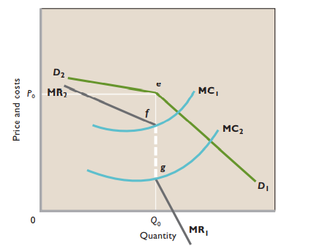
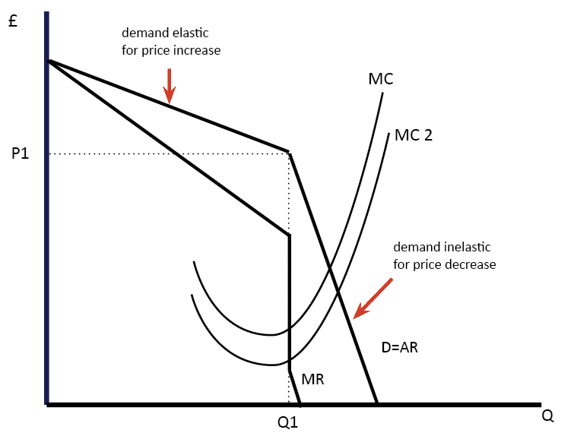
Oligopoly pricing models – kinked Demand curve
Mc Connell & Brue pg. 456

Slide 14
Cartels and Collusion
Collusion: any agreement to fix prices, divide up the market, or otherwise restrict competition
Each firm acts as if it were a pure monopolist
If oligopolistic firms face identical or highly similar demand and cost conditions, they may collude to limit their joint output and to set a single, common price.

Slide 15
Collusion and Joint-Profit Maximization
MC
P
Price and Costs
ATC
P₀
Economic profit
A₀
D
MR=MC
MR
Q₀
Q

Slide 16
Cartels and Collusion
If prices are charged higher than rivals, firm loses out on demand and hence total revenue, especially if rivals don’t match price increase.
If Price is set below equilibrium by rivals, firm may retaliate by cutting its price too, but this will move all three firms down their demand curves, lowering their profits. It may even drive them to a point where average total cost exceeds price and losses are incurred.
Faced with the same demand and cost circumstances, each firm will find it most profitable to charge the same price.
To ensure the above outcomes do not occur , firms may agree to collude and set the same price to get maximum profit.

Slide 17
Cartels and Collusion
Overt collusion
Cartel , a group of producers that typically creates a formal written agreement specifying how much each member will produce and charge. Output must be controlled—the market must be divided up—in order to maintain the agreed-upon price. The collusion is overt, or open to view.
Covert collusion
Where s Cartels are illegal, collusion that exists is covert or secret. Informal agreement to fix the prices and sales volume
  Tacit understandings (historically called “gentlemen’s agreements”) frequently made through informal associations and in social gatherings. A verbal agreement between competing firms on product price, leaving market shares to be decided by nonprice competition. Because they are not proper legal agreements, they are difficult to detect.

Slide 18
Cartels and Collusion
Obstacles to Collusive pricing
Demand and Cost Differences lead to disagreements on price. Particularly in industries where products are differentiated and change frequently. Even with highly standardized products, firms usually have somewhat different market shares and operate with differing degrees of productive efficiency. Therefore, even if they are homogeneous oligopolists it is likely that they would not have the same demand and cost curves, thus profit-maximizing price will differ among firms and no single price will be readily acceptable to all.
Number of Firms the larger the number of firms, the more difficult it is to create a cartel or some other form of price collusion. Agreement is difficult to achieve when some smaller firms outside of the collusion may well be competitive.

Slide 19
Cartels and Collusion
Obstacles to Collusive pricing
Cheating Collusive oligopolists may secretly engage in price cutting to increase sales and profit. When buyers paying a high price for a product become aware of the lower-priced sales, they demand the same. Some buyers receiving a price concession from one producer may use the concession as a wedge to get even larger price concessions from a rival producer. Buyers’ attempts to play producers against one another may precipitate price wars among the producers. Although secret price concessions are potentially profitable, they threaten collusive oligopolies over time. Collusion is more likely to succeed when cheating is easy to detect and punish.

Slide 20
Cartels and Collusion
Obstacles to Collusive pricing
Recession Long-lasting recession results in increase average total cost. As demand decreases, revenues fall. Average total cost increases as firms face excess production capacity, and profits fall. Businesses may cut prices to minimize loss or too much profit reductions and thus gain sales at the expense of rivals
Potential Entry The greater prices and profits that result from collusion may attract new entrants, including foreign firms, increase market supply and reduce prices and profits, successful collusion requires that colluding oligopolists block the entry of new producers.
Legal Obstacles: Antitrust Law U.S. antitrust laws prohibit cartels and price-fixing collusion. So less obvious means of price control have evolved in this country

Slide 21
Price Leadership Model
Dominant firm leads the way
Implicit understanding by which oligopolists can coordinate prices without engaging in outright collusion based on formal agreements and secret meetings. Dominant firm, usually largest or most efficient in industry initiates price changes and all other firms more or less automatically follow the leader
  Leadership Tactics
  Breakdowns in Price Leadership: Price Wars

Slide 22
Price Leadership Model
Leadership tactics
  Infrequent Price Changes
  Since price changes are risky that rivals will not follow the lead, price adjustments are made only infrequently, most likely when cost and demand conditions have been altered significantly and on an industrywide basis.
  Communications
  Informal communication of need for price changes so that competitors follow the lead. Through trade publication interviews etc.
  Limit Pricing
  To discourage new competitors and maintain the current oligopolistic structure of the industry, the price leader may keep price below the short-run profit-maximizing level acting as a barrier to entry of new firms which may be inefficient or unable to charge low price.

Slide 23
Price Leadership Model
Breakdowns in price leadership: price wars
Most price wars eventually run their course. When all firms recognize that low prices are severely reducing their profits, they again yield price leadership to one of the industry's leading firms. That firm then begins to raise prices, and the other firms willingly follow suit.

Slide 24
Oligopoly and Advertising
Oligopolists prefer not to compete on price so focus is on non price competition
  Product development and advertising preferred as it gives more permanent gains in market share and cannot be duplicated as quickly and completely as price reduction
  Oligopolists have sufficient financial resources
  Economic profits earned in the past can help finance current advertising and product development.

Slide 25
Positive Effects of Advertising
Low cost source of information for consumers
Can diminish monopoly power
Introduction of new products designed to compete with existing brands.
Impact on oligopoly
It is an inexpensive means of providing useful information to consumers, lowering their search costs. As competition is enhanced, advertising results in greater economic efficiency. This facilitates the introduction of new products, encourages technological advancements. As output increases, long-run average total cost falls enabling firms to obtain economies of scale.

Slide 26
Negative Effects of Advertising
Only persuasion, not information regarding product
May persuade consumers to pay high prices for much-acclaimed but inferior products, forgoing better but unadvertised products selling at lower prices.
Barrier to entry
Firms with better advertising may capture greater market share, reap higher profits, in turn do even better advertising and get even greater market shares, leading to a monopolized market and disadvantage for customers of losing out on competition.
Self-cancelling advertising
Entails large expenditures on advertising by firm but when competitors do the same, it contributes little to stimulate demand

Slide 27
SUMMARY
Oligopoly
  Characteristics
  Industrial concentration
  Pricing models
    Kinked-demand curve
    Collusive pricing
    Price leadership
  Oligopoly and advertising

